Slide 1


The Machine Learning Behind Recommender systems
Diego Galeano, Ph.D.

Slide 2
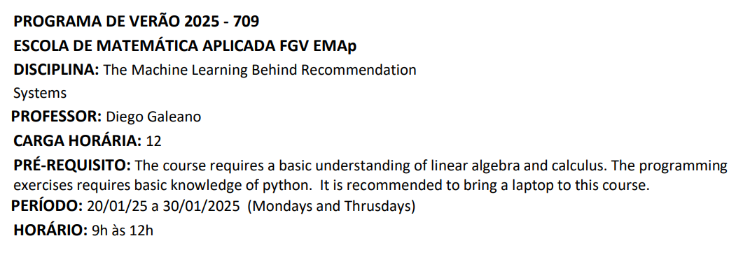
The course

Slide 3
Evaluating Recommender Systems

Slide 4
Introduction
Key Points:
Evaluation of recommender systems shares similarities with classification and regression modeling.
Differences arise due to the unique goals of recommender systems.
Proper evaluation design ensures accurate measurement of algorithm effectiveness.
Focus: Importance of multifaceted evaluation criteria.

Slide 5
Online vs. Offline Evaluation
Online Evaluation:
User participation required.
Example: A/B testing in a news recommender system.
Measures conversion rate (e.g., user clicks).
Challenges: Access to large-scale user data.
Offline Evaluation:
Uses historical datasets.
Common in research due to accessibility and versatility.
Focus on generalization across multiple domains.

Slide 6
Key Considerations for Evaluation
Evaluation Goals:
Beyond accuracy: novelty, trust, coverage, serendipity.
Subjective but essential for user experience.
Experimental Design Issues:
Avoid overestimation/underestimation of metrics.
Importance of careful data partitioning.
Accuracy Metrics:
Key metrics: Mean Absolute Error (MAE), Mean Squared Error (MSE), etc.
Ranking evaluation: utility-based methods, rank-correlation coefficients.

Slide 7
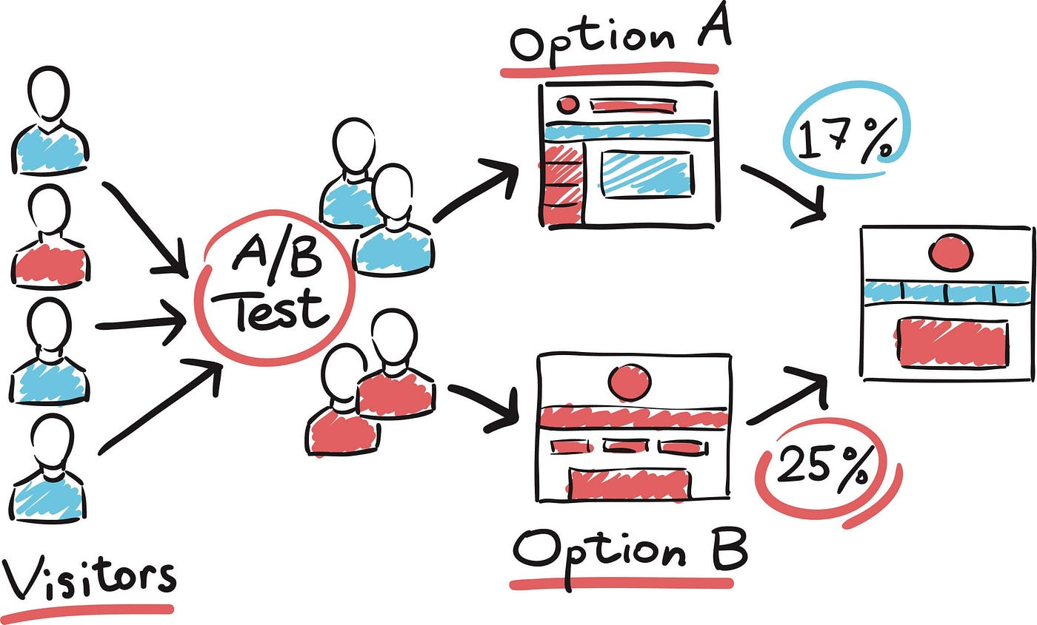
Online Evaluation
Used in already deployed RecSys.
Conversion rate: measure the frequency at which recommended items are selected by users.
A/B Testing:
Segment randomly selected users intro groups A and B.
Use Algorithm X for group A for a period of time T.
Use Algorithm Y for group B for a period of time T.
Compare the conversion rate of both cases.

Slide 8
Offline Evaluation with Historical Data Sets
Historical data: ratings
Dataset can be split into training, validation and testing sets.
Most popular in the literature.

Slide 9
Evaluation procedure
Rating prediction: similar to regression
RMSE, MSE.
Ranking (Top-N RecSys): similar to classification.
recall@top-K.

Slide 10
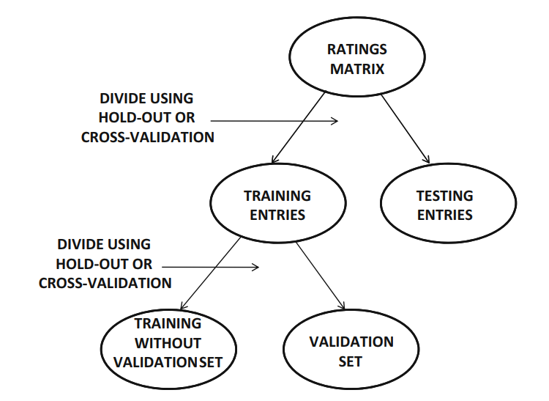
General procedure

Slide 11
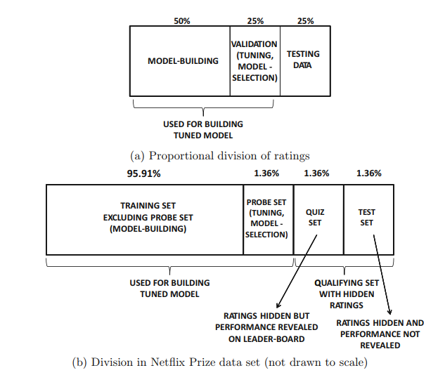
Netflix Prize Competition Example (rating prediction - RMSE)

Slide 12
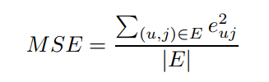
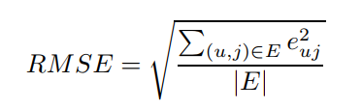

Rating estimation performance
Mean square error (MSE)
Root-MSE (RMSE)
(entry-specific error)

Slide 13
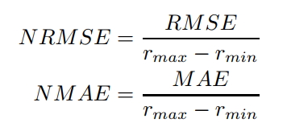
Other metrics
Normalized RMSE (NRMSE)
Normalized MAE.

Slide 14
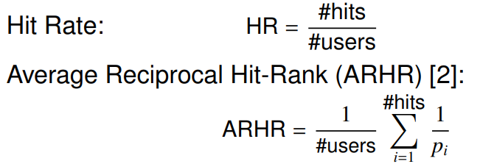

Evaluation in top-N RecSys
Randomly remove an item for each user
Try to recover the item that was removed in the top-K recommendations
Measure the recall@top-K (Hit rate).
$p_{i}:$position at which the item was predicted.

Slide 15
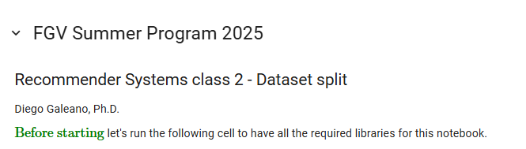
Coding session 2

Slide 16
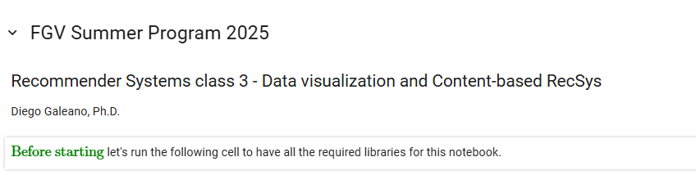
Coding session 3

